Slide 1
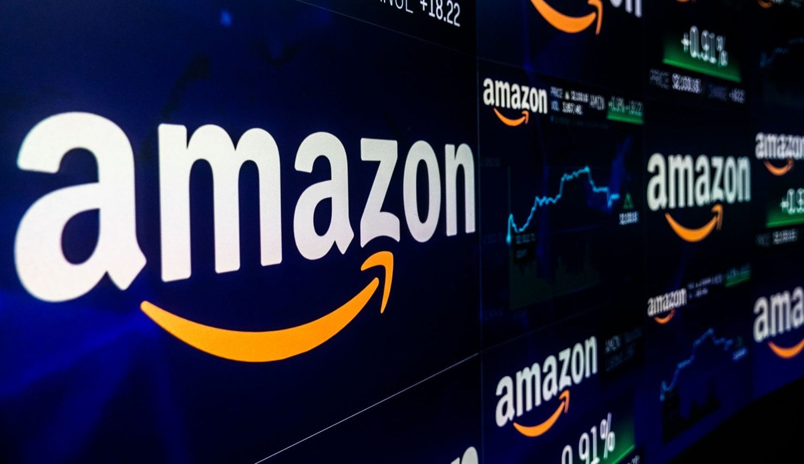
Course: New Product Development (MADSC203)
Final Assessment
Team members:
Kumar Gaurav 22026384
Abhinav 22026594
Kingsley Essien 21033121
Mehdi Izadpanah 22028184
Professor: Hildegard Haas

Slide 2
Agenda
-Introduction ............................Kumar Gaurav................................ .....Slides 3-4
-Summary of process.............. Kumar Gaurav......................................Slide 5
-Product Innovation Charter.....Kumar Gaurav......................................Slides 6-7
-Marketing Research
-Patent strategy
-Platform technologies
-Specification of the product
-Production
-New Product Development processes
-Organizational structure
-Concept testing
-Commercialization
-Conclusions
-References

Slide 3
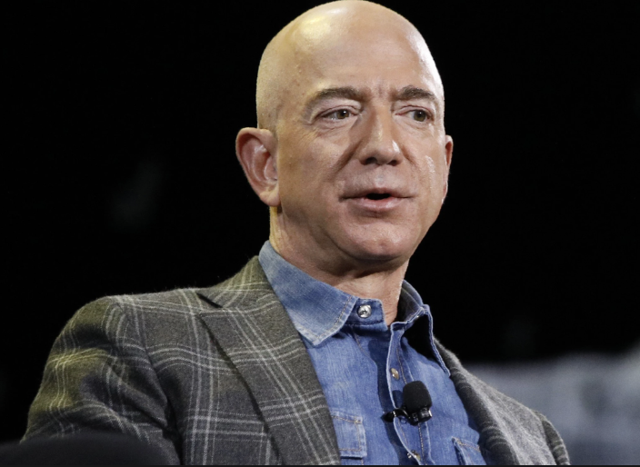

INTRODUCTION
Jeff Bezos established Amazon.com, Inc. in the United States in 1994.The first global websites were launched in 1998.
Millions of businesses choose Amazon Business as their primary online shopping destination. It provides all the benefits that Amazon customers love, including availability, convenience, and quick, dependable shipping, in addition to special features and benefits for businesses of all kinds.
The company offers goods in a variety of categories, including clothing, auto and industrial equipment, beauty and health care, electronics, groceries, books, games, jewellery, kids' and infant products, movies, music, sporting goods, toys, and tools, among others.
E-commerce, cloud computing, digital streaming, artificial intelligence, and online advertising are some of Amazon's business interests.
Some other Services Offered by Amazon are Prime Video, Amazon Music, Amazon Pay, Amazon Prime
Amazon Dash, Amazon Smile, Amazon Advertising etc.
This Photo by Unknown Author is licensed under CC BY

Slide 4
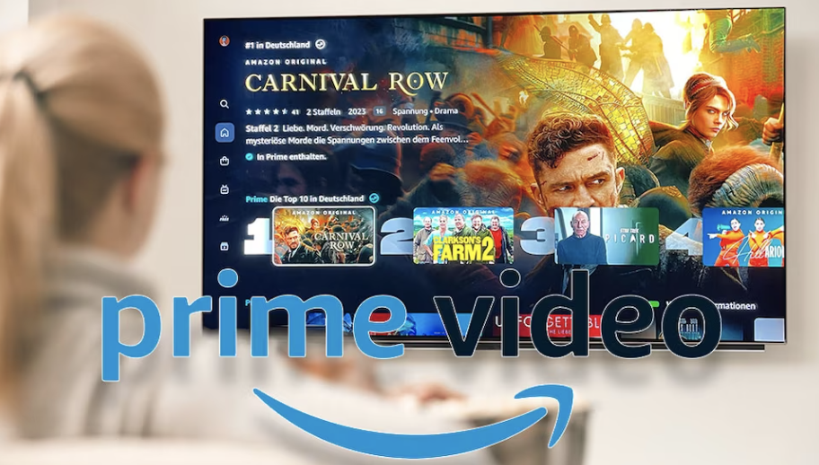


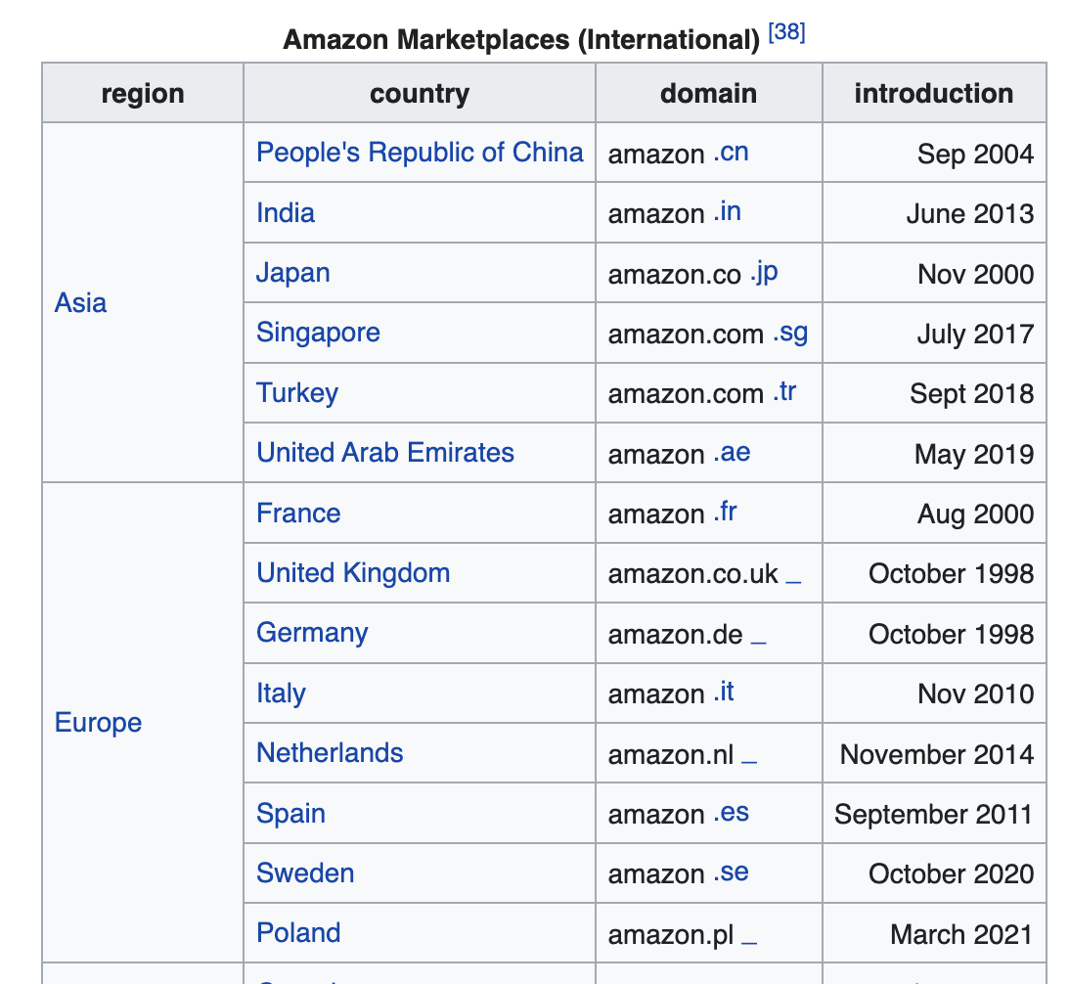
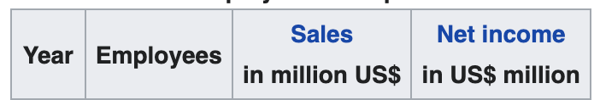
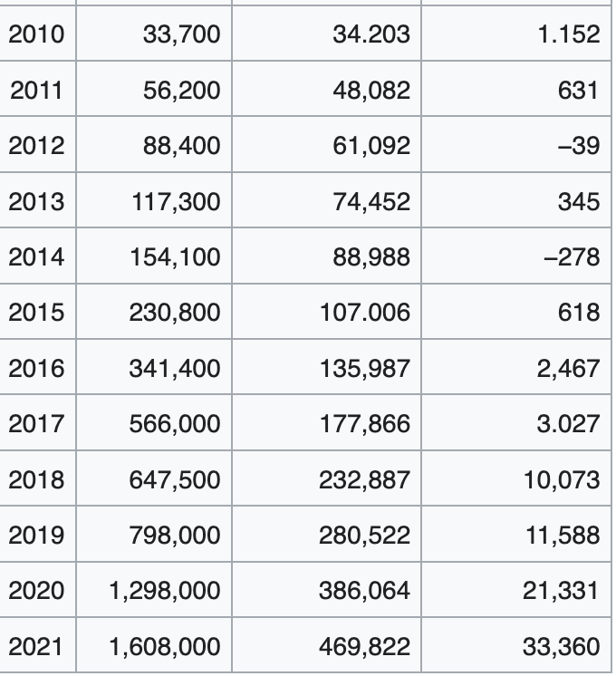
Busniess and employee Developmennt

Slide 5
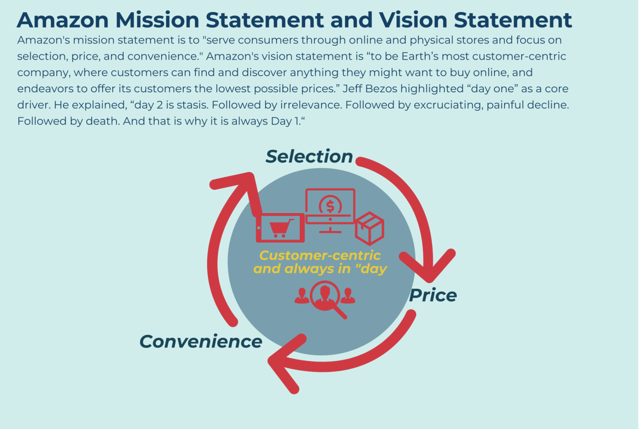
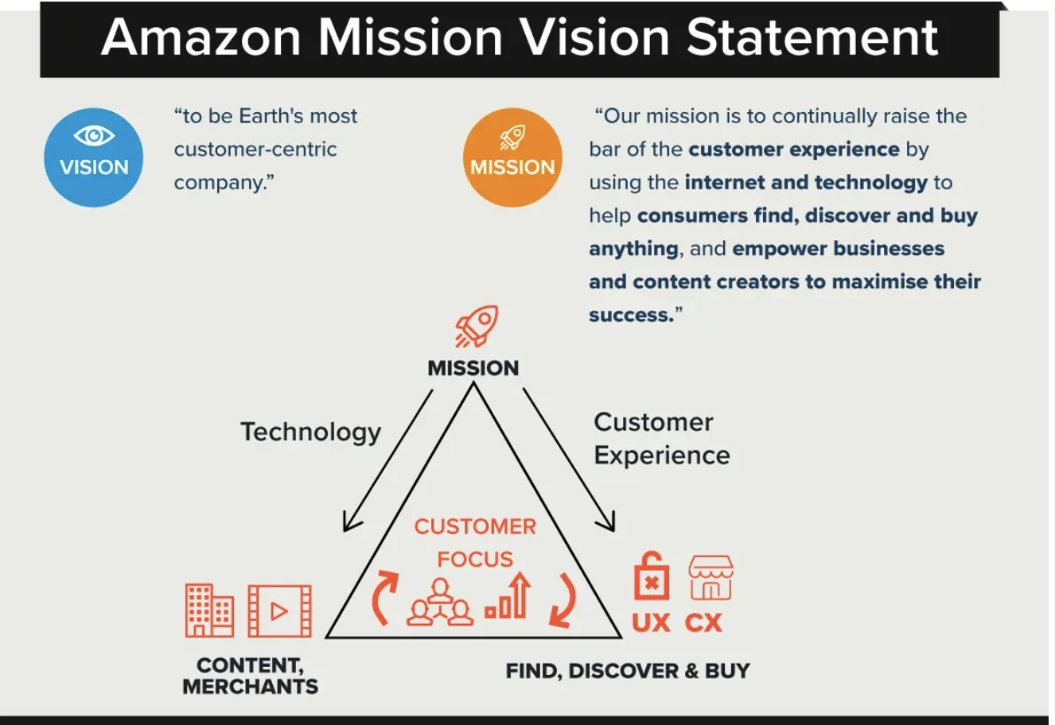
This Photo by Unknown Author is licensed under CC BY

Slide 6
Product Innovation charter.
Key Point to a Successful E-commerce Business
Delivered a Good Product with great Price.
Think like your Target Users Do
Never Stop Advertising!
Implement new idea according to customer needs.
By help of MI understand requirement of customer.
Amazon is e-commerce company offers goods in a variety of categories, including clothing, auto and industrial equipment, beauty and health care, electronics, groceries, books, games, jewellery, kids' and infant products, movies, music, sporting goods, toys, and tools, among others.
Target market segment
The target market for Amazon, which has about 120 million products for sale on its website, includes people from all socioeconomic backgrounds, including singles, families, professionals, and people with low to high incomes. People all over the world.
This Photo by Unknown Author is licensed under CC BY

Slide 7
Core Competencies
Distribution and logistics.
Building Platforms That Can Survive on Their Own.
Making use of technology.
USPs (Unique selling point)
Quick shipping and a vast range,
Amazon offers great value.
Amazon has worked to identify the customer wants that it is certain won't change ever since it first started.
Customers will almost certainly want their items faster and cheaper no matter what the future holds.
Guildelines of amazon
These some verification requried by the guildelines of Amazon.
Profile verification
Contact Details Verification
Vaild Adress Verification (Through Pin)
Alians verification
Vaild Cerdit or Debit card required for payment.
Bank OTP Verification During the time of payment
This Photo by Unknown Author is licensed under CC BY

Slide 8

DELIGHT FACTORS OF AMAZON
FOCUS ON INNOVATION
UNPRECEDENTED CUSTOMER SERVICES
PRODUCT REVIEWS
UNLIMITED PRODUCT PREPOSITION
LOYALTY PROGRAMS
Potential retailers learn a lot from AMAZON, which motivates them to succeed in their pursuits.
This Photo by Unknown Author is licensed under CC BY

Slide 9
PRICE PREFERENCE – KANO VOC
This Photo by Unknown Author is licensed under CC BY

Slide 10
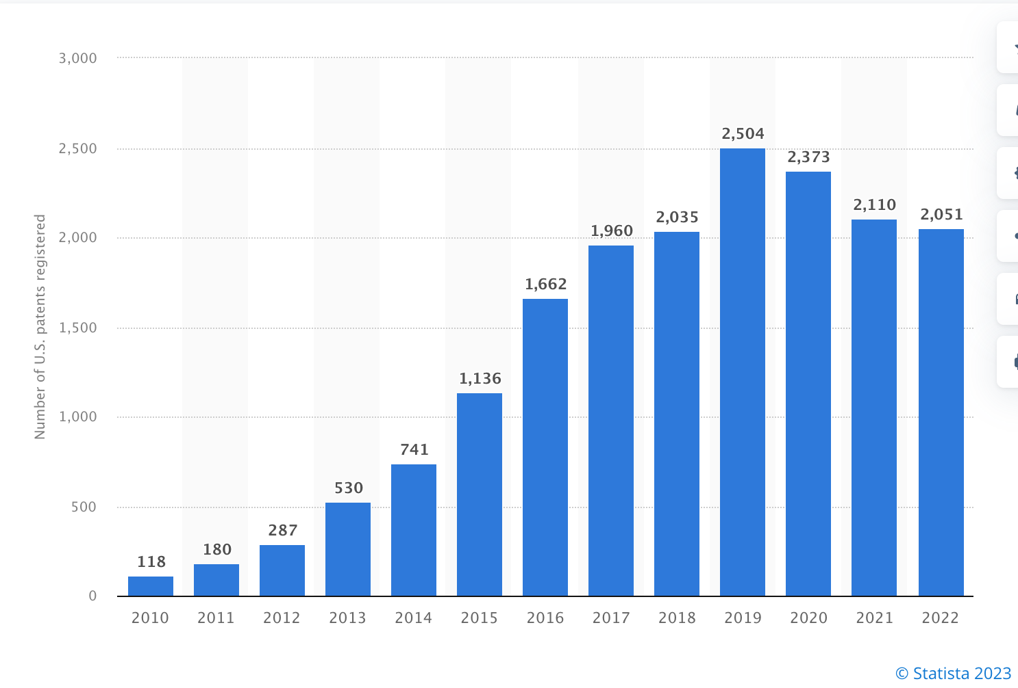
The United States Patents and Trademarks Board issued a total of two thousand and fifty one patents to Amazon Systems in two thousand and twenty two. In comparison to the prior year, this shows a 3% declination in the number of United States patents awarded.
PATENT STARTEGY
HOW TO CHECK PATENT
Search for list on Amazon
2. Order a Product sample
3. Search Online
This Photo by Unknown Author is licensed under CC BY

Slide 11

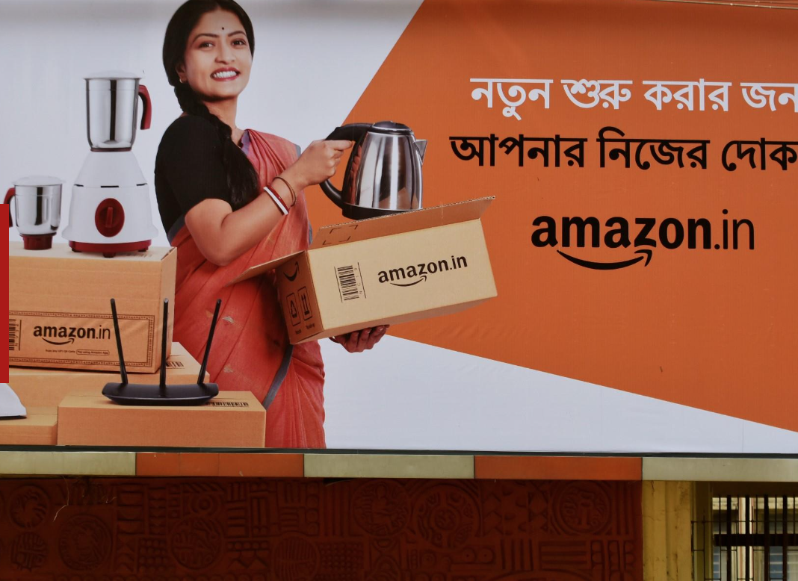
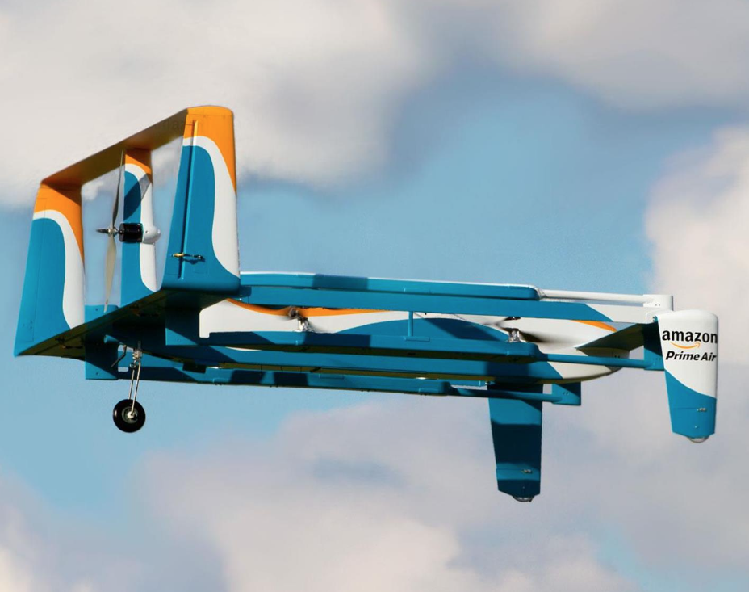
PLATFORM TECHNOLOGIES – FUTURE PRODUCTS
AI POWERED ROBOT
DIGITISED TRADING IN INDIA
FLEET OF DELIVERY DRONES
This Photo by Unknown Author is licensed under CC BY

Slide 12
Specification of the product; Strategy: The Everything Store , autonomous vehicle, satellite internet, food market and much more.
It also provides variety of downloadable and streaming options through Prime, video, music, twitch, & audible units.
Private labeled product: They sells many products under its own brand name, including phone chargers, batteries, and diaper wipes.
Third-party sellers: Some other large e-commerce sellers are using amazon to sell their products, In addition to their own websites.
Affiliate program, Product review, Amazone sales rank, etc..
This Photo by Unknown Author is licensed under CC BY

Slide 13
Amazon is a massive global corporation that produces and sells wide range of products and services.
Advertising: it operates massive advertising platforms which helps them to increase their profits by advertising the product and services on company’s websites and other digital properties.
Amazon also provides other companies to advertise through their websites by paying to be listed as featured product then sells their product by taking their small percentage from the sales price.
Worldwide
Rev: $513.98 billion (2022)
No.employees; 1,541,000
8th of the fortune 500 ranking(largest united state corporations by total revenue)
This Photo by Unknown Author is licensed under CC BY

Slide 14




New product development processes;
Speed Agility Supplier open
development Innovation
Two-pizza team
New product will be flexible, developed in small incremental steps to pivot quick response to customer feedback and market changes.
Collaborate with suppliers through development program to improve manufacture, ensuring quality.
Fosters open innovation by encouraging employee collaboration& external innovators to work with them.(Alexa fund)
Overall, Amazon's NPD process focused on speed, agility, supplier development and open innovation.
These processes have trigger the company to
Innovate continuously and introduce new products and services to market that delight its customer.
Small group of employees empowered to make quick decision and bring product to market fast.
Kelly, S.M. (2019) Amazon employees put pressure on Jeff Bezos to release climate change plan | CNN business, CNN. Cable News Network. Available at: https://www.cnn.com/2019/04/10/tech/amazon-climate-change-letter/index.html (Accessed: March 14, 2023).
Amazon (company) (2023) Wikipedia. Wikimedia Foundation. Available at: https://en.wikipedia.org/wiki/Amazon_(company) (Accessed: March 14, 2023).

Slide 15
Organizational structure and its relationships
Organizational structure affects the relationships between departments and functions and the management of activities.
Companies use project management and cross-functional teams in the purpose of Organizational structure.
shorter development time
Cross-functional teams
higher product innovativeness
Cross-functional teams in Decentrlized Structure of Amazon
Agile teams
Bunduchi, R. (2009) Implementing best practices to support creativity in NPD cross-functional teams, International Journal of Innovation Management, vol. 13, no. 4, 537–54.

Slide 16
Concept testing
The main purpose of screening ideas is to find out the idea will be successful or not.
Testing who and how????
Different kinds of feedbacks can be observed from potential customer discussions and developed prototypes.
In February 2021, Amazon identified three concepts which were compatible with Alexa.
smart sticky note printer | smart nutrition scale | smart cuckoo clock
Stock, R.M. (2014) How should customers be integrated for e!ective interorganizational NPD teams? An input–process–output perspective, Journal of Product Innovation Management, vol. 31, 535–51.

Slide 17
commercialization
Is the main part starts after positive feedback from market testing.
Advertising is a large part of costs.
Amazon automatically commercializes its products and services.
Different businesses use amazon for increasing their sale.
By the service to the sellers and also buyers commercialization happens in a less costly way.

Slide 18
conclusion
Amazon used NPD strategies in different categories from the start of its business until now.
Amazon tries to be an enjoyable environment for costumers.
Project management and cross-functional teams are used in Amazon’s organizational structure.

Slide 19
References
Amazon (company) (2023) Wikipedia. Wikimedia Foundation. Available at: https://en.wikipedia.org/wiki/Amazon_(company) (Accessed: March 14, 2023).
Kelly, S.M. (2019) Amazon employees put pressure on Jeff Bezos to release climate change plan | CNN business, CNN. Cable News Network. Available at: https://www.cnn.com/2019/04/10/tech/amazon-climate-change-letter/index.html (Accessed: March 14, 2023).
Bunduchi, R. (2009) Implementing best practices to support creativity in NPD cross-functional teams, International Journal of Innovation Management, vol. 13, no. 4, 537–54.
Stock, R.M. (2014) How should customers be integrated for e!ective interorganizational NPD teams? An input–process–output perspective, Journal of Product Innovation Management, vol. 31, 535–51.
Why is Amazon so successful? Amazon Success Story (no date) Dinarys. Available at: https://dinarys.com/blog/amazon-success-story (Accessed: March 15, 2023).
About currency of preference (no date) About Currency of Preference - Amazon Customer Service. Available at: https://www.amazon.co.uk/gp/help/customer/display.html?nodeId=GCFKTYVC8YXJLQDH (Accessed: March 15, 2023).
|, R.S. (2021) How to check patents on Amazon: 3 ways, Prosper Show | Prosper Show. Available at: https://prospershow.com/media/prosper-blog/how-to-check-patents-on-amazon-3-ways/#:~:text=A%20utility%20patent%20protects%20the,re%20not%20violating%20patent%20laws. (Accessed: March 15, 2023).
|, R.S. (2021) How to check patents on Amazon: 3 ways, Prosper Show | Prosper Show. Available at: https://prospershow.com/media/prosper-blog/how-to-check-patents-on-amazon-3-ways/#:~:text=A%20utility%20patent%20protects%20the,re%20not%20violating%20patent%20laws. (Accessed: March 15, 2023).
Published by Daniela Coppola and 15, F. (2023) Number of U.S. patents registered by Amazon 2022, Statista. Available at: https://www.statista.com/statistics/897773/amazon-patents-usa-registered/#:~:text=Number%20of%20patents%20granted%20to%20Amazon%20in%20the%20U.S.%202010%2D2022&text=In%202022%2C%20Amazon%20Technologies%20was,compared%20to%20the%20previous%20year. (Accessed: March 15, 2023).
What Amazon is planning to do next (no date) Live life richer with Lovemoney. Available at: https://www.lovemoney.com/galleries/77190/what-amazon-is-planning-to-do-next?page=1 (Accessed: March 15, 2023).

